Slide 1
PAYROLL MANAGEMENT AND PAYMENT RECONCILIATION SYSTEM FOR SOCIAL PENSION PROGRAM WITH INTEGRATED DATA QUALITY ASSURANCE
A Proposed Solution for Social Pension Disbursement Automation
Mit 265 – Advanced Software Engineering
Alden A. Quiñones

Slide 2
Background of the Study
The Social Pension Program aims to assist economically disadvantaged senior citizens.
Challenges include:
- Manual disbursement process causing delays
- Difficulty in beneficiary identity verification
- Increasing grievances due to discrepancies
A centralized database system is proposed to enhance efficiency and data integrity.

Slide 3
Statement of the Problem
Lack of data quality assurance leading to duplicate and fraudulent entries.
Manual data processing causing delays in disbursement and liquidation.
Difficulty in tracking beneficiary status, affecting payroll preparation.

Slide 4
General Objective
To develop a web-based application system that automates Social Pension Disbursement Processes and provides real-time tracking of beneficiaries.

Slide 5
Specific Objectives
Develop and implement a data validation and quality assurance mechanism.
Automate the payroll processing, disbursement, and liquidation process.
Integrate real-time monitoring and reporting features to facilitate payroll processing.

Slide 6
Functional Requirements
Mobile Field Validation and updating of beneficiary information.
Real-time Dashboard for Monitoring of Disbursement Progress.
Automatic Data Analytics for Data Quality Assessment.
Duplicate beneficiary detection using Jaro-Winkler Algorithm.
Task Queuing & Background Processing with Celery and Redis.
Generate Printable Payroll/Reports

Slide 7
Non-Functional Requirements
Production Server:
Accessible Only via IPVPN thru Global Protect Portal
Load balancing and Auto-scaling (Kubernetes Environment)
Zero Downtime (ATS and ISP Automatic Failover)

Slide 8
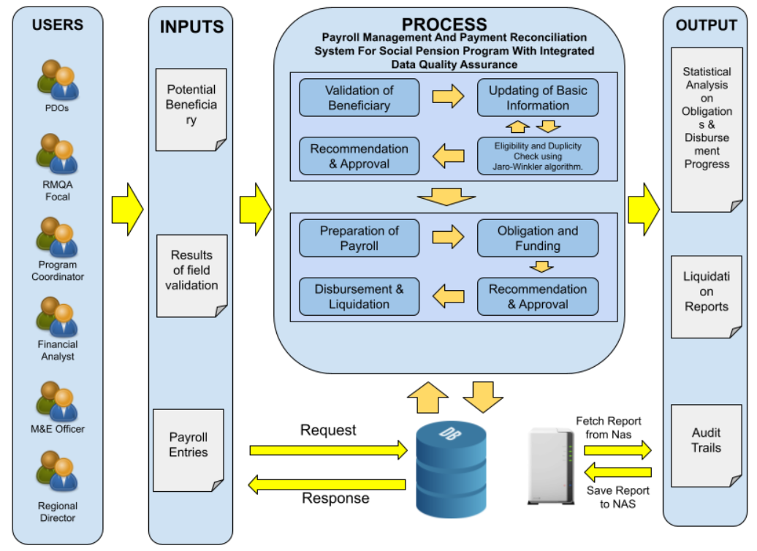
Conceptual Framework

